Slide 1
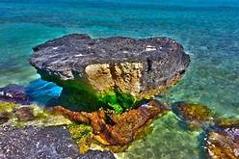
The 10th APOCP General Assembly April 3-5, 2020
The Community Preventable Fraction of Cancer Risk
The Kish Iland

Slide 2
The Sponsor:
APOCP’s West Asia Chapter
West Asia Organization for Cancer Prevention

Slide 3
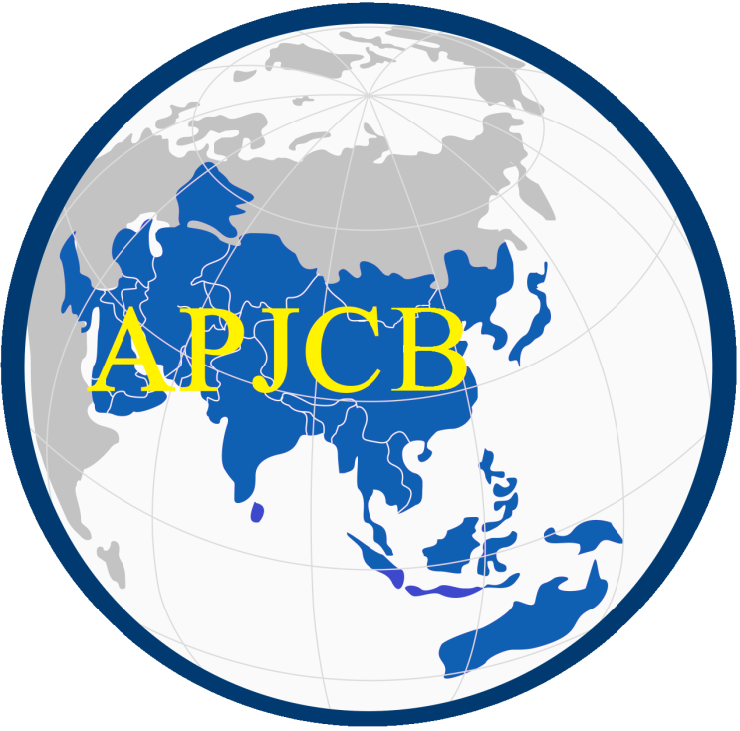
The venue
The Marina Park Hotel,
Kish Iland,
Iran

Slide 4
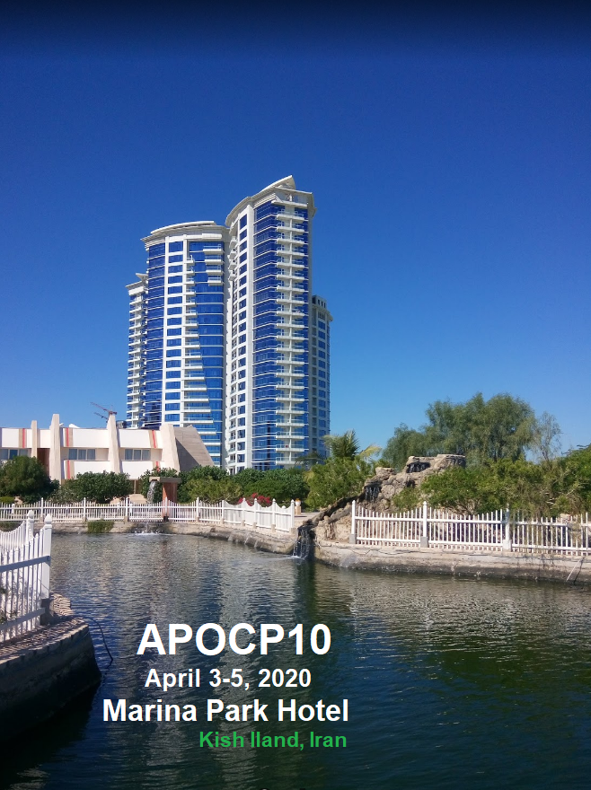
The People:
Honorary President:
Kazuo Tajima Nagoya, Jpan (2002)
Yoon-Ok Ahn Seoul, Korea (2004)
Thiravud Khuhaprema Thailand (2006)
Youlin Qiao Beijing, China (2008)
Nejat Ozgul Istanbul, Turkey (2010)
Cheng-Har Yip Kuching, Malaysia (2012)
Chien-Jen Chen Taipei, Taiwan (2014)
Jeff Dunn Brisbane, Australia (2016)
President:
Dr. Alireza Mosavi jarrahi

Slide 5
See You, All
In Kish Iland
April 3-5 2020

